Slide 1

MENTAL HEALTH AND PRODUCTIVITY: INSIGHTS FROM EMPLOYEE DATA
An Insightful Look into the Impact of Stress and Mental Health of employee on Workplace Productivity.
- ABDUL HADI S
Notes:
Photo by NON on Unsplash
Photo by Jermaine Ee on Unsplash
Photo by tom coe on Unsplash

Slide 2


OBJECTIVE
This report aims to analyze the relationship between mental health, stress levels, and employee productivity. The focus is on understanding how factors like work-life balance, access to mental health resources, and social isolation influence overall productivity and job satisfaction.
OBJECTIVE:
DATASET OVERVIEW
The dataset comprises over 5000 employee information across multiple industries, covering variables such as job role, age, gender, stress levels, work-life balance ratings, and access to mental health resources.

Slide 3
KEY INSIGHTS
Stress levels vary by job and age, with employees aged 20-30 and designers experiencing less stress, while those aged 30-50 and project managers face more stress.
Stress level by Jobrole and age
When stress level increase, work-life balance of the employee gradually decreases.
Impact of worklife balance on stress
How stress impacts productivity
The productivity of the employee is increasing when the stress level of the employee is low
Notes:
Photo by Marcelo Cidrack on Unsplash

Slide 4
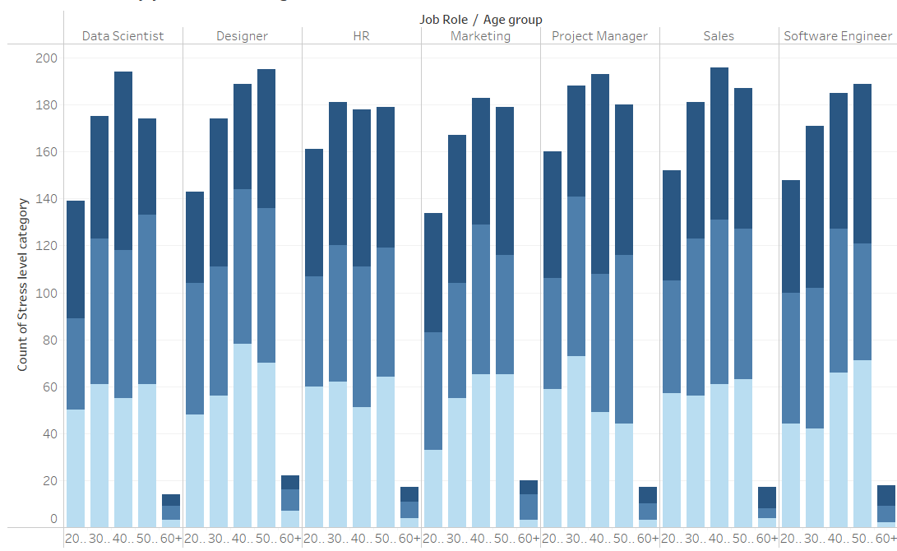
STRESS LEVEL BY JOBROLE AND AGE
Stress levels vary significantly across job roles and age groups.
Employees aged 40-50 in project manager role report the highest stress levels, with 60% in this group experiencing high stress.
Employees with age above 50 have low stress level compared to other age groups.

Slide 5
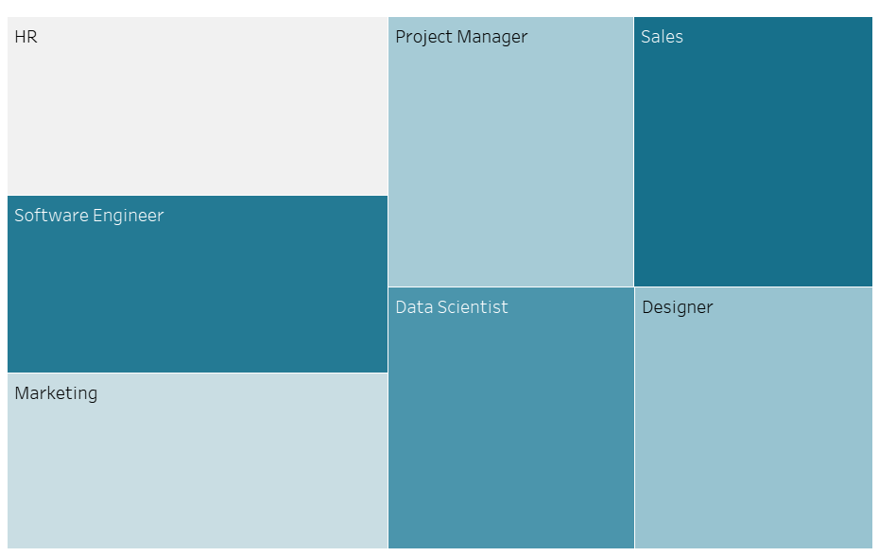
IMPACT OF WORK-LIFE BALANCE ON STRESS
A clear correlation exists between work-life balance and stress levels.
Employees with poor work-life balance are 50% more likely to report high stress compared to those with a good balance.
Sales job role have a high work-life balance with low stress levels.
HR job role have low work-life balance with high stress levels.

Slide 6
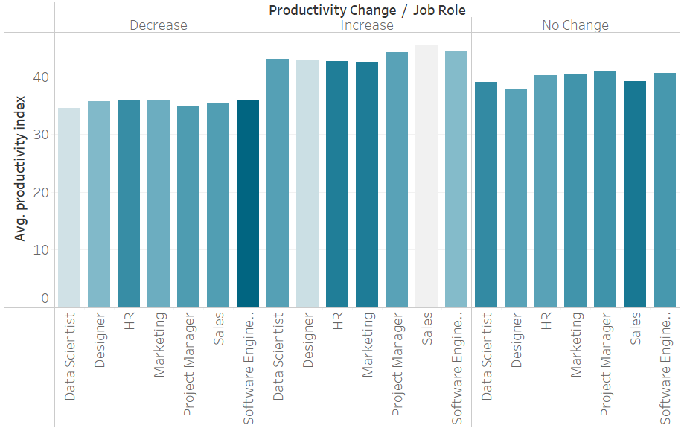
HOW STRESS IMPACTS PRODUCTIVITY
Employees experiencing high stress levels see a 35% decrease in productivity, while those with lower stress report up to a 20% increase in their output.
We can clearly see that productivity is increasing with decreasing in stress level.
Software Engineer role have high stress level, so decrease in productivity.
Sales role have low stress level, so their productivity has increased.

Slide 7
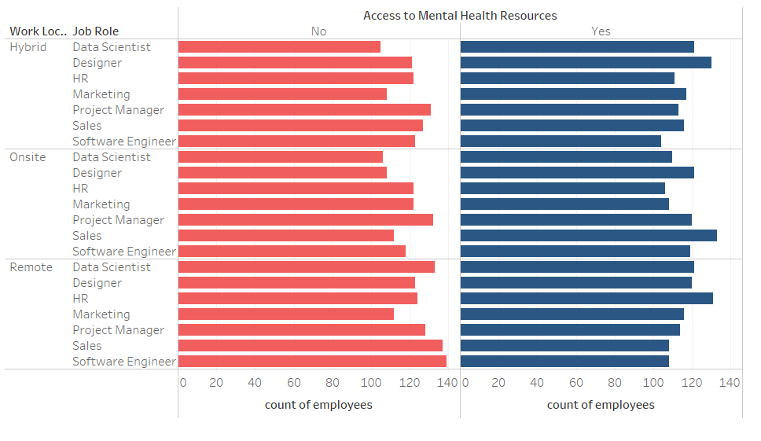
ACCESS TO MENTAL HEALTH RESOURCE BY WORK LOCATION
Employees with access to mental health resources report a 25% improvement in productivity. This suggests a strong link between mental health support and employee performance.
Remote software engineers and sales professionals have limited access to mental health resources, which can lead to increased stress.

Slide 8
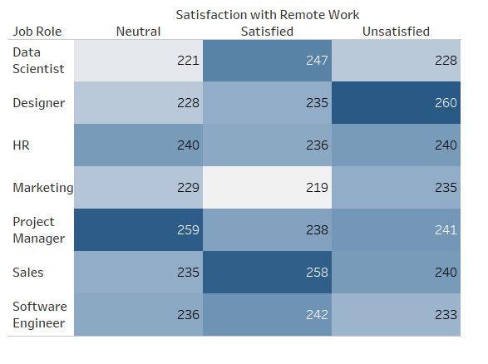
SATISFACTION WITH REMOTE WORK BY JOBROLE
Most of the Designers are unsatisfied with remote work.
The employees from sales job role are satisfied with remote work.

Slide 9
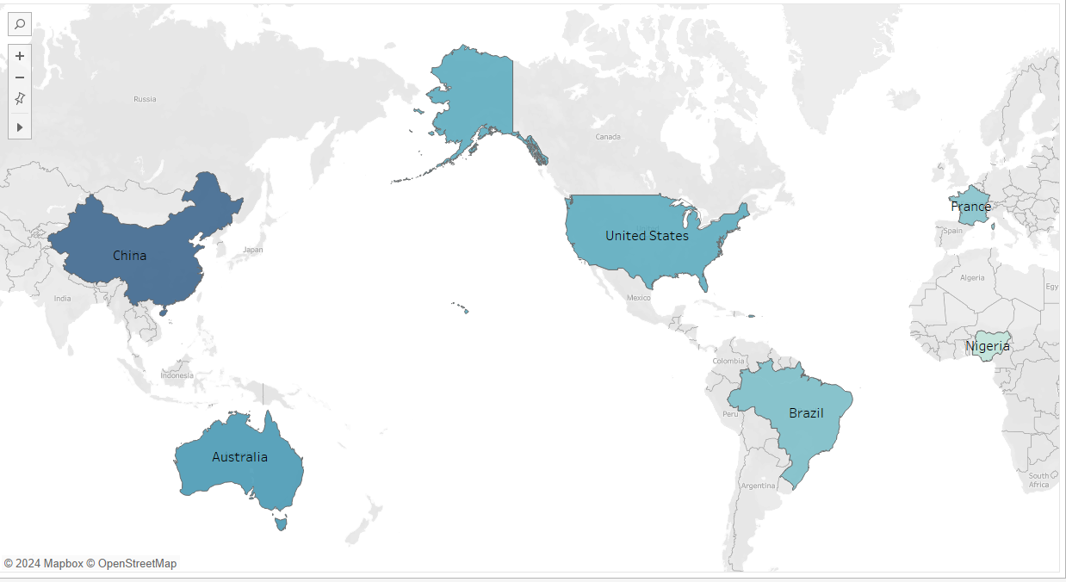
STRESS LEVEL BY REGION
The employees who work’s in China face high stress compared to other countries , so their productivity has decreased by 30%.
The employees who work’s in Nigeria face low stress compared to others , so their productivity has increased by 10%.

Slide 10
RECOMMENDATIONS
Enhance Mental Health Resources
Provide regular access to mental health services and support to reduce stress and boost productivity.
Encourage hybrid work models to improve work-life balance and employee well-being.
Promote Flexible Work Models
Organize workshops and seminars to educate employees about mental health, stress management techniques, and the importance of seeking help.
Mental Health Awareness Programs
Notes:
Photo by Marcelo Cidrack on Unsplash

Slide 11

THANK YOU
- ABDUL HADI
This Photo by Unknown Author is licensed under CC BY-SA-NC
Notes:
Photo by Kyle Cesmat on Unsplash

